Slide 1
Apache Spark & PySpark
Nathan Jarvis

Slide 2

What is Apache Spark & PySpark
Apache Spark is an open-source, distributed computing framework for big data processing
Built for speed, ease of use, and scalability
Supports batch processing, streaming, machine learning, and graph processing
PySpark is the API for Apache Spark that allows you to use the capabilities of Spark
Notes:
Nathan

Slide 3
Why use PySpark
Spark handles large datasets much more efficiently compared to packages like Pandas, which struggles with memory constraint
Supports a plethora of other packages like NumPy, SciKit-Learn, and Pandas, allowing for flexible and powerful data workflows
Designed for distributed computing, PySpark can scale across multiple nodes, making it ideal for enterprise-level data processing
PySpark allows for SQL queries on big data and real-time stream processing with Spark Streaming. Also Works seamlessly with cloud platforms like AWS, Azure and on-premises clusters like Hadoop
Notes:
Nathan

Slide 4
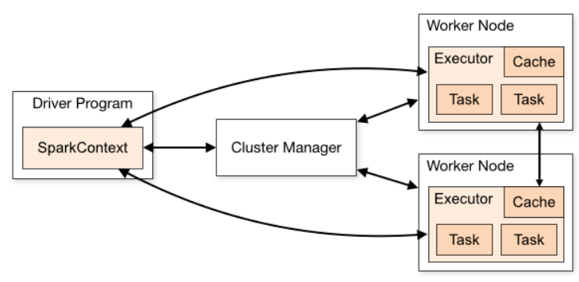
Architecture of Spark
A Spark application consists of a driver program and multiple worker nodes
The driver coordinates tasks, manages execution, and communicates with the cluster
Worker nodes run executors that process data in parallel across the cluster or local threads
Data is distributed among workers, enabling parallel processing for faster computation
A cluster manager handles resource allocation across nodes
Notes:
Nathan

Slide 5
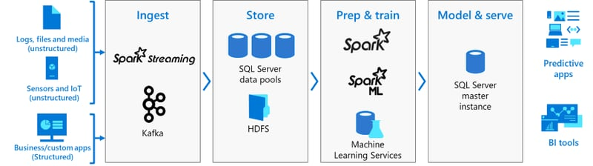
More About Apache Spark
Ingest: Spark collects data from various sources, including logs, sensors, and business applications. It can process data in real-time using Spark Streaming and Kafka
Store: The data is saved in storage systems like SQL databases and HDFS (a type of big data storage
Prep & Train: Spark’s machine learning tools help clean the data and train models to find patterns and make predictions
Model & Serve: The trained models are used to power business insights, predictive applications, and BI tools.
Notes:
Nathan

Slide 6
How PySpark Works
RDDs are low-level distributed data structures for fine-grained control. DataFrames offer a high-level, tabular format with optimizations (like scalable Pandas
PySpark requires initializing a SparkSession, which serves as the main entry point for Spark operations. It can run locally on a laptop for testing or on clusters for large-scale processing
from pyspark.sql import SparkSession spark =SparkSession.builder.appName("MyApp").getOrCreate()
PySpark can read data from CSV, JSON, databases, and cloud storage. It uses DataFrames, which are optimized for big data processing, like Pandas but distributed across multiple machine
df = spark.read.csv("data.csv", header=True, inferSchema=True)
Notes:
Nathan

Slide 7
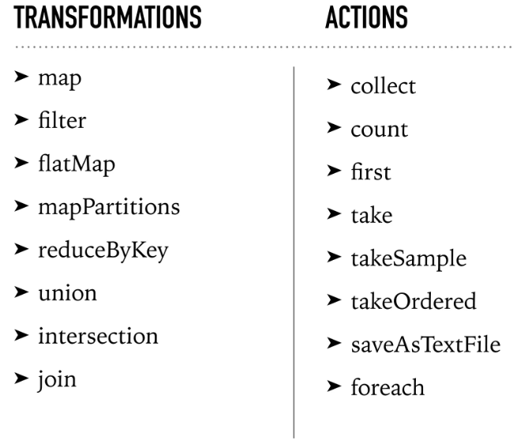
Common Functions
Transformations create new RDD’s
Actions trigger computations and return results to the driver or write to storage
data = [1, 2, 3, 4, 5]
rdd = spark.sparkContext.parallelize(data)
doubled_rdd = rdd.map(lambda x: x * 2)
driverresult = doubled_rdd.collect()
print(result) = [2, 4, 6, 8, 10]
Notes:
Nathan

Slide 8

Real-Time Point-of-Sale Analytics using Apache Kafka and PySpark
Gabriel McReynolds & Nathan Jarvis

Slide 9
Introduction
Point-of-sale analytics is the process of collecting and analyzing data from the processing of transactions at a retail store
With volatility in the market and narrowing margins in retail, POS analytics is critical for retailers to ensure they are running their inventory management program as effectively as possible
If a POS system stores and reports data about inventory, retailers can have a better idea of what they're selling, what they're storing and what isn't moving.

Slide 10

Introduction Cont.
Derived from Databricks Solution Accelerator Real-Time Point-Of-Sale Analytics
Instead of using Delta Live Tables, transaction data is captured via Kafka and streamed in real-time ensuring low-latency processing
The project diverges from the original framework by replacing managed services with a custom Python server setup for cost efficiency and greater control over event handling.
Provides a scalable framework adaptable to diverse retail environments, making it suitable for dynamic, fast-paced operations

Slide 11
Overview
DaData
DaData
DaData
DaData
DaData
Data Introduction
Architecture and Workflow
Data Preparation & Analysis
Latency Analysis
Conclusion

Slide 12
Understanding the Data
Inventory Snapshot Files: Record inventory levels for items at specific times for online and in-store locations
Inventory Change Files: Track changes to items in inventory (sold, shrink, restock, bopis) with timestamps, quantities, and transaction ID
Metadata Files
Change Types: Maps reasons for inventory changes
Items: Details like item name, supplier, and safety stock
Store: Store names and IDs or online

Slide 13
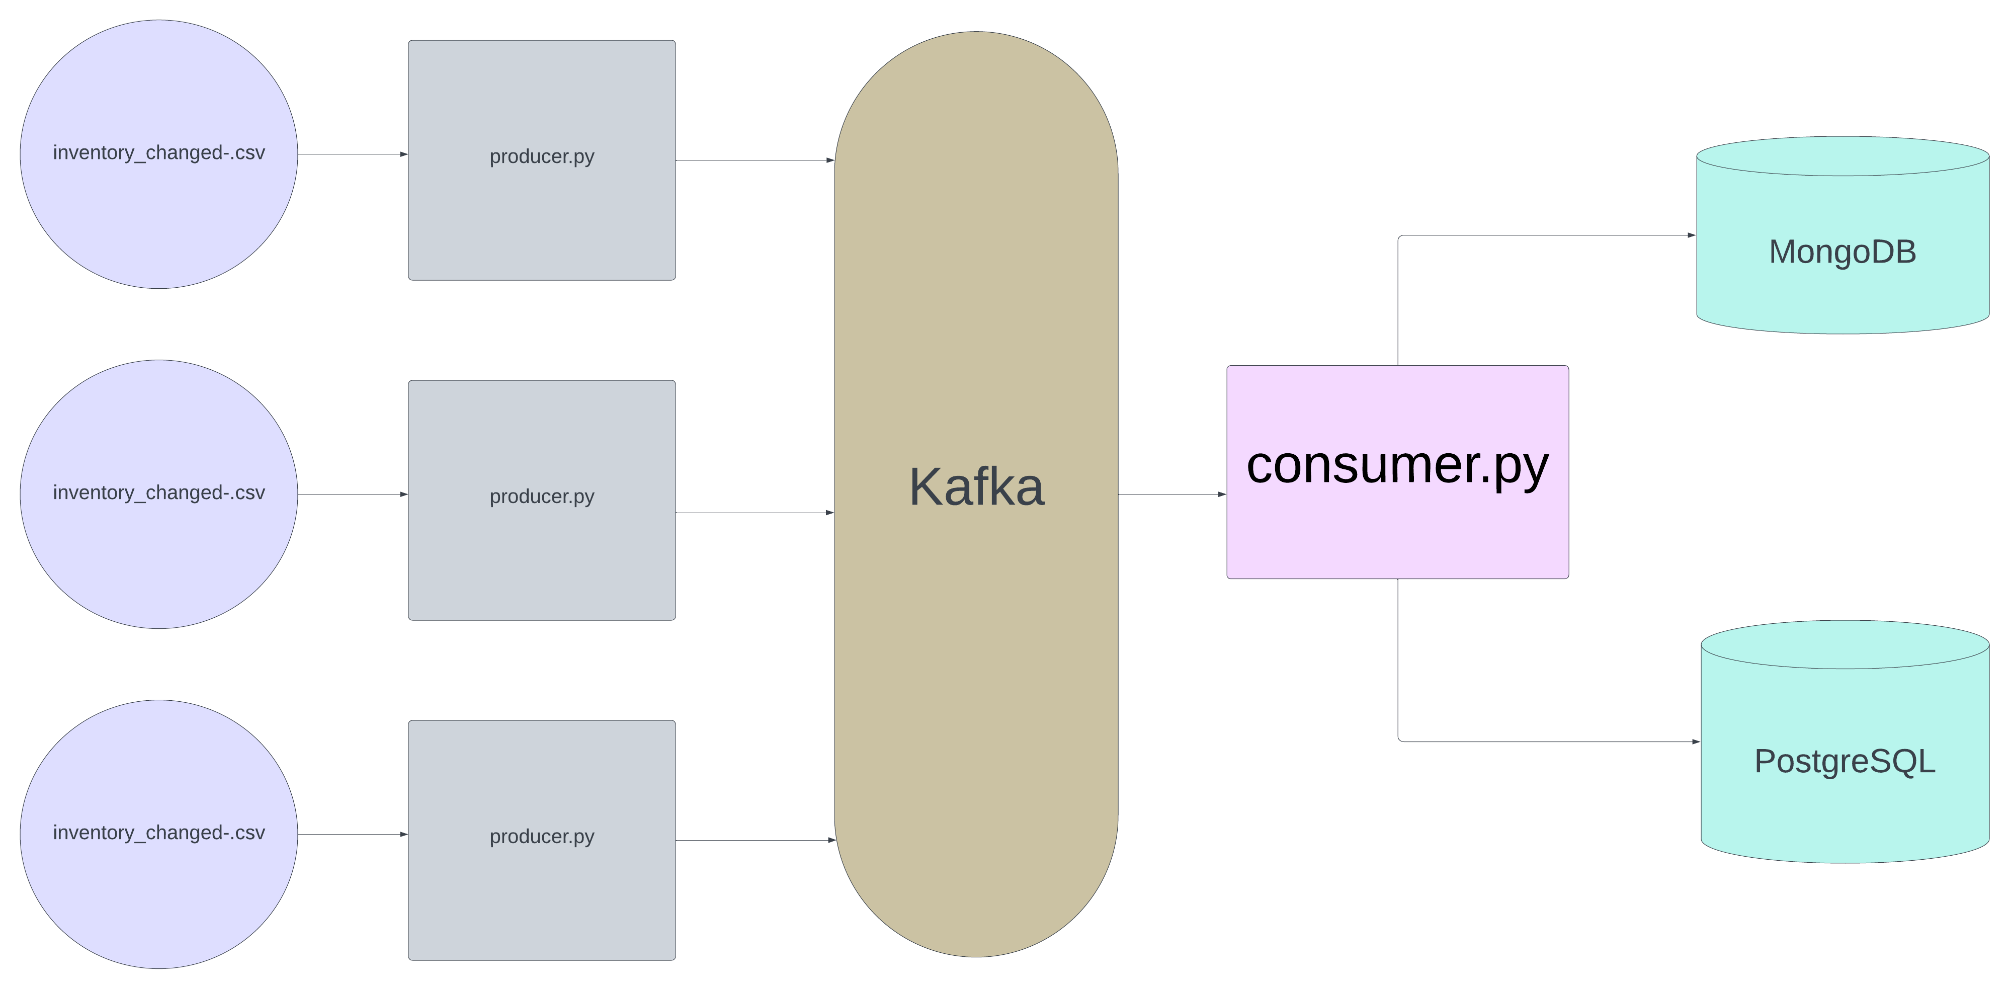
Architecture and Workflow

Slide 14
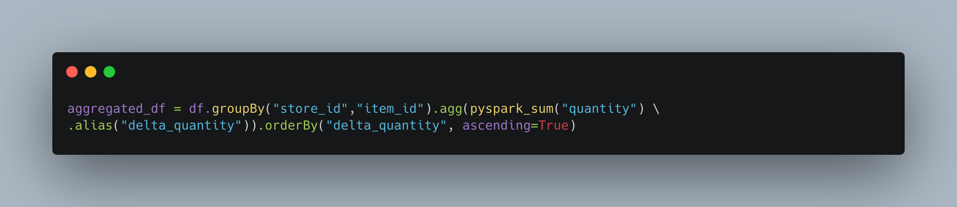
Latency Analysis
MongoDB
Batch
Single
SQL (Postgres)
Batch
Single

Slide 15
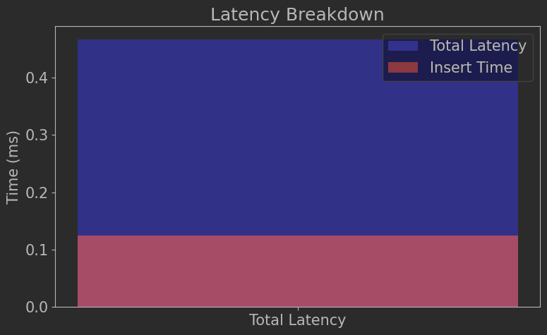
Overall Latency Breakdown
Latency Calculation is averaged over all rows in a batch (~3,000 rows)
Insert time is not a huge portion of latency

Slide 16
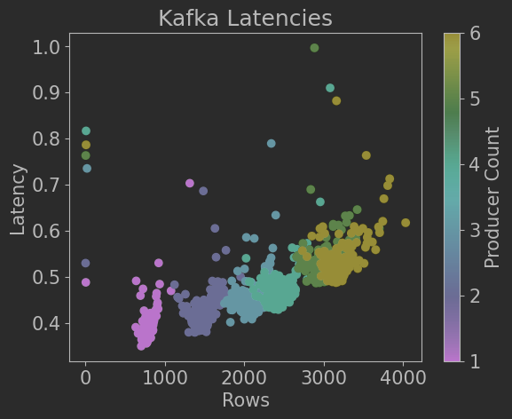
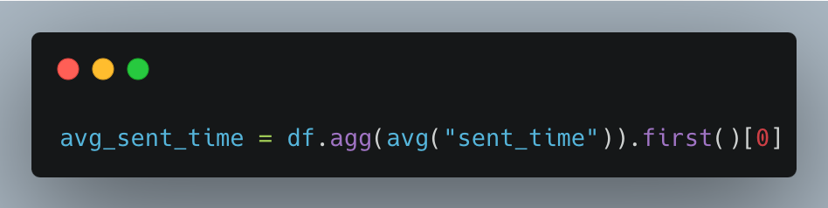
Latency Collection
producer.py adds a sent_time to each row
Time for batch = processing_end – avg_sent_time
Each dot represents one Kafka batch
Increased strain by running multiple producers (color)

Slide 17
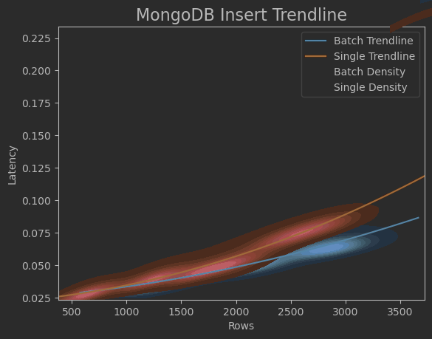
MongoDB Single vs Batch
Batch takes less time to insert (fewer inserted rows)
Single takes less as batch size increases

Slide 18
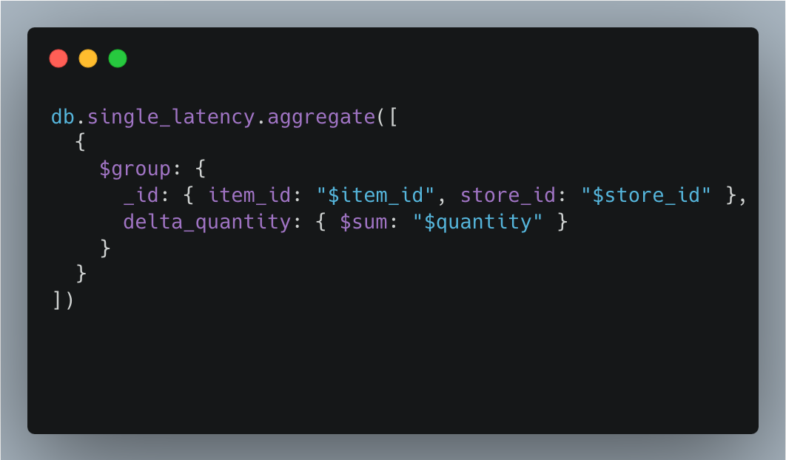
MongoDB Aggregate Query
Single takes ~2.4 seconds
Batch takes ~1.6 seconds

Slide 19
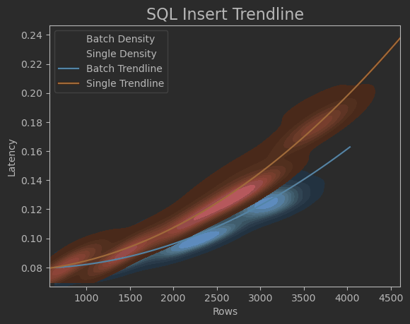
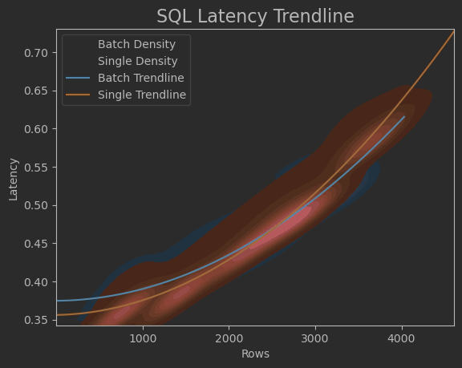
PostgreSQL Single vs Batch
Similar story to MongoDB

Slide 20
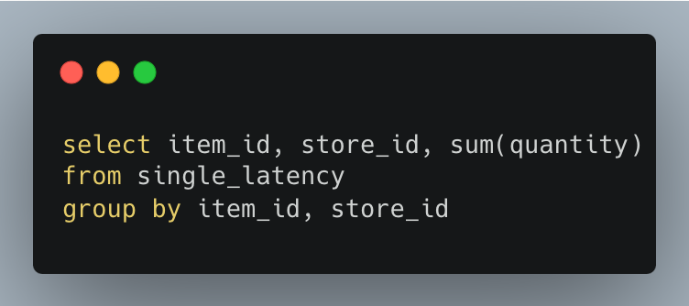
PostgreSQL Aggregate Query
Single takes ~1.5 seconds
Batch takes ~.8 seconds
Significantly faster than MongoDB

Slide 21
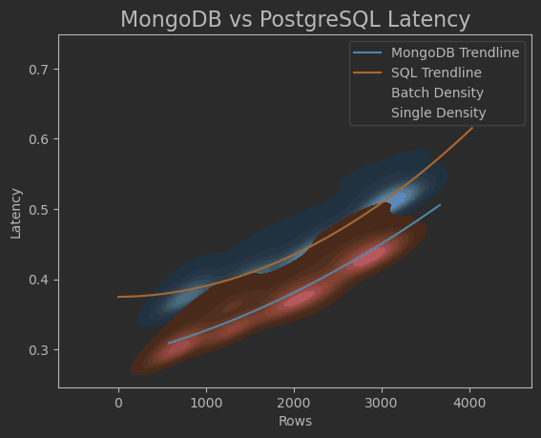
MongoDB vs PostgreSQL
SQL is more influenced by batch size
MongoDB has faster insert times
SQL has faster aggregation times

Slide 22
Updating the Data for Analysis
A combined CSV was created by processing the results of snapshots and change files from Kafka topics, joined with metadata and the timestamp
Important Fields
Item ID
Date Time
Quantity
Source Type (snapshot_only or snapshot_w_change)
Store Name (names of stores or online)
Action (the corresponding change type, if no change type, then it is inventory report)
Final Quantity (quantity from snapshot + quantity from change)

Slide 23
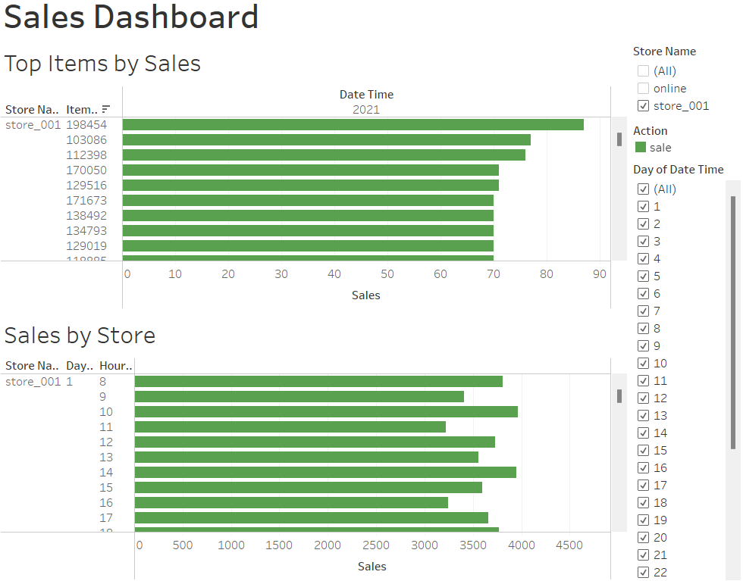
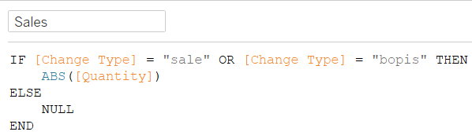
Analysis
Compare sales per store to see items that are preforming well
Compare sales per store by day and hour

Slide 24
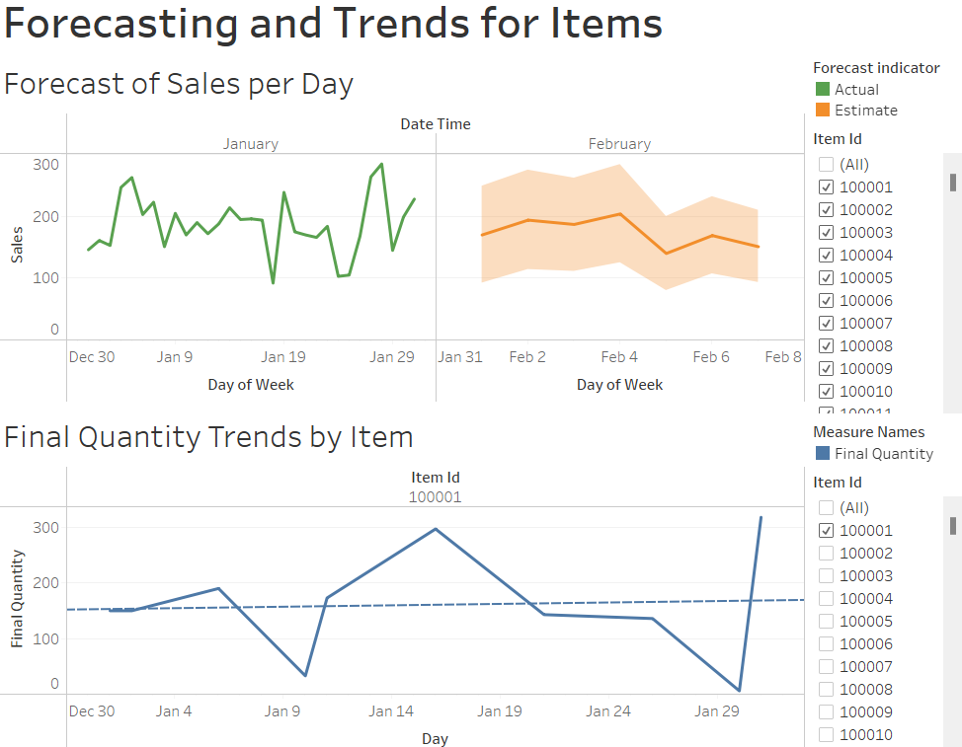
Analysis
Filter between items to get forecasted view of sales for each item for the next month
Can compare with current final quantity

Slide 25
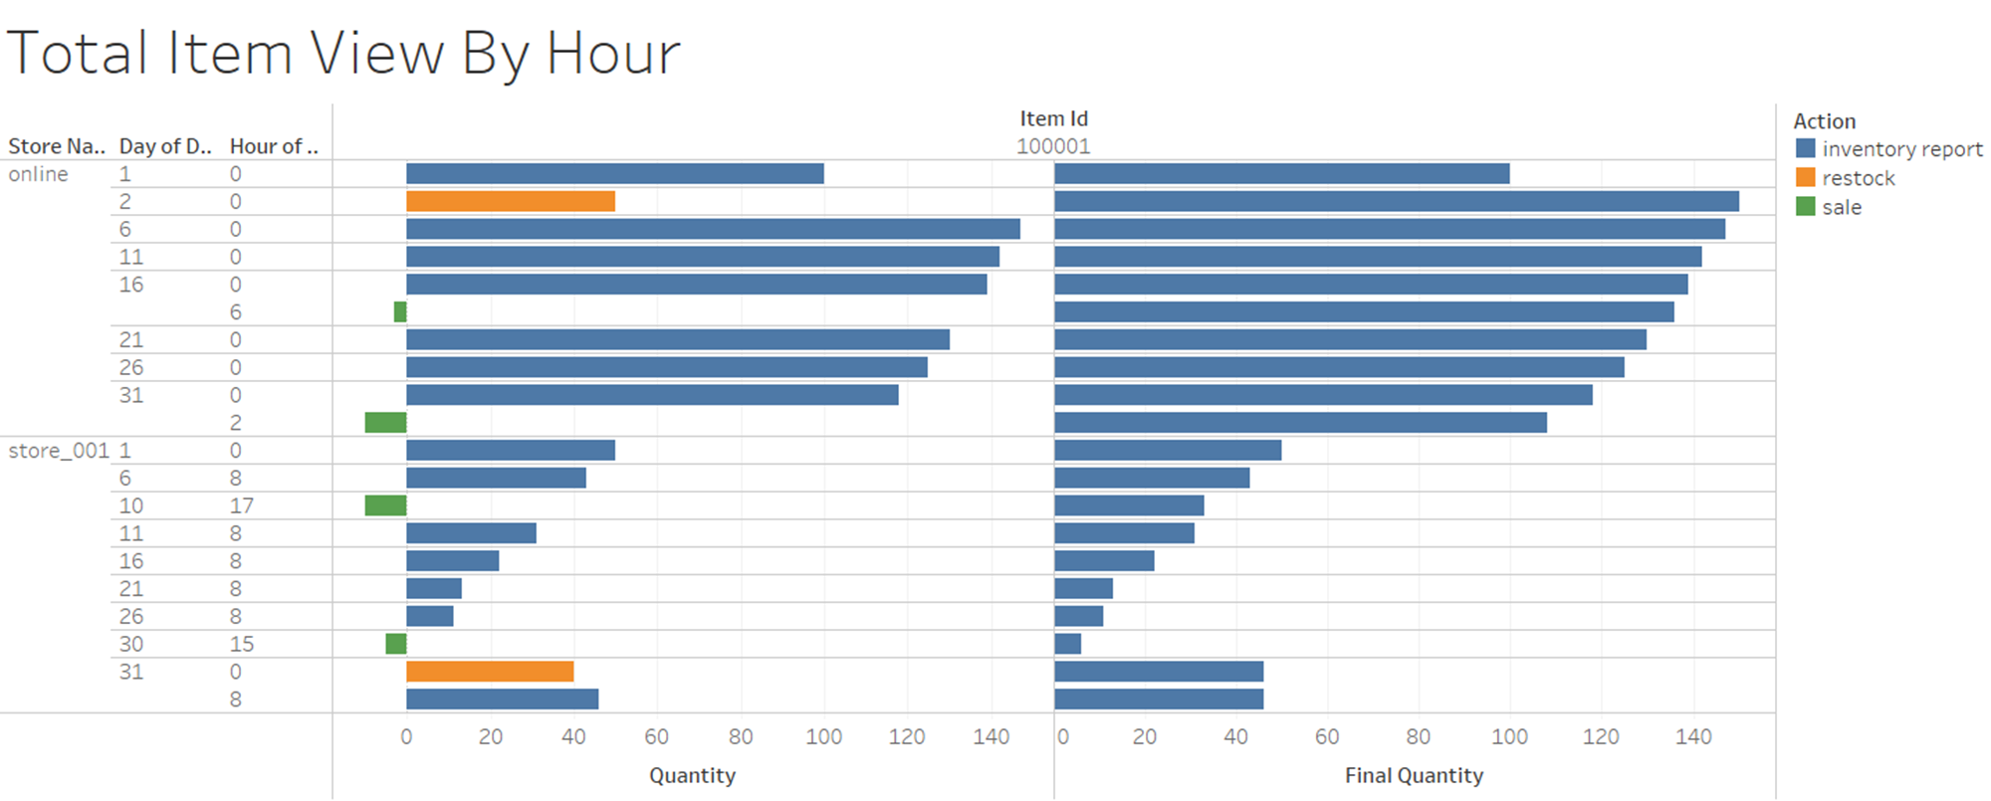
Analysis
If extra insight about an item is needed, you can filter to that item and see specific quantity and the change type and compare to final quantity

Slide 26
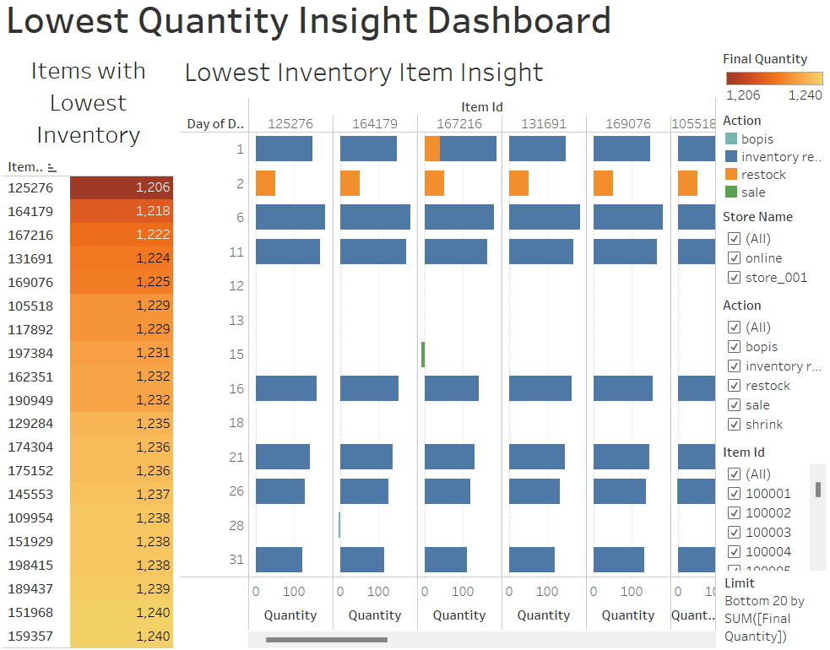
Analysis
See 20 items with the lowest current inventory
Get info on those items to see their activity per day and hour

Slide 27
Real-Time Streaming
We can stream this all together by creating a workflow with a trigger that runs every hour
Every hour it will rerun our producer to bring in the new data from the POS system and update our topics
After running the producer, a trigger will activate to run the consumer. After creating the file to export there will be a pipeline to a tableau file with visuals that can be refreshed to get real-time analytics

Slide 28
Future Improvements
Investigate if SQL and MongoDB indexes can reduce query time
Create better forecasting in Tableau after data grows to ample size and spans over months
Put items into clusters to perform analysis to get better insights on similar items
Track seasonality to better understand how to items and clusters are moving around different times of the year

Slide 29
Conclusion
Batch processing Kafka stream is most efficient for saving and querying data
MongoDB inserts faster but SQL can query faster for aggregate query
The data needs preparation and aggregating before analysis can be done
There is a lot that can be forecasted currently, but more descriptive analytics needs more time and data

Slide 30
Questions?

